Slide 1


Gökhan Elbistan
22.04.2024

Slide 2

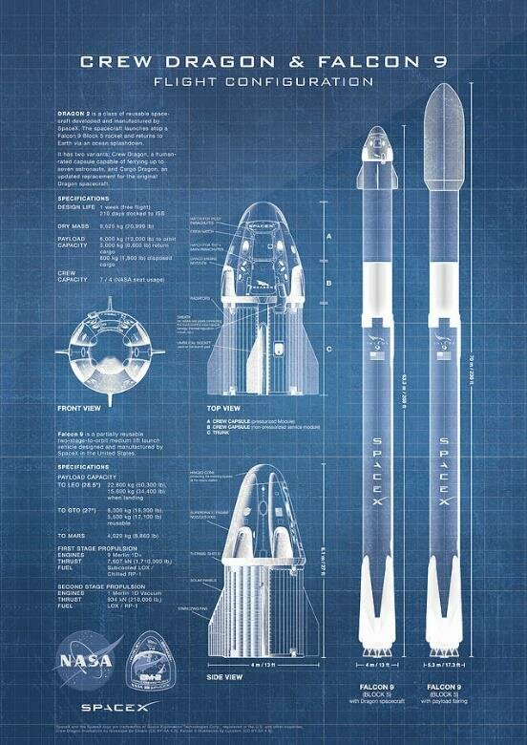
Outline
Executive Summary
Introduction
Methodology
Results
Conclusion
Appendix

Slide 3
Executive Summary
Summary of methodologies
Data collection
Data wrangling
Exploratory Data Analysis with Data Visualization
Exploratory Data Analysis with SQL
Building an interactive map with Folium
Building a Dashboard with Plotly Dash
Predictive analysis (Classification)
Summary of all results
Exploratory Data Analysis results
Interactive analytics demo in screenshots
Predictive analysis results

Slide 4
Introduction
Project background and context
SpaceX is the most successful company of the commercial space age, making space travel affordable. The company advertises Falcon 9 rocket launches on its website, with a cost of 62 million dollars; other providers cost upward of 165 million dollars each, much of the savings is because SpaceX can reuse the first stage. Therefore, if we can determine if the first stage will land, we can determine the cost of a launch. Based on public information and machine learning models, we are going to predict if SpaceX will reuse the first stage.
Research Questions
How do variables such as payload mass, launch site, number of flights, and orbits affect the success of the first stage landing?
Does the rate of successful landings increase over the years?
What is the best algorithm that can be used for binary classification in this case?

Slide 5

Section 1

Slide 6
Methodology
Executive Summary
Data collection methodology:
Data was collected with SpaceX Rest API and Web Scraping from Wikipedia with BeautifulSoup
Perform data wrangling
Filters were applied on the data, missing values has been dealt with and one hot encoding has been used to transform categorical variables into integer from SVM.
Perform exploratory data analysis (EDA) using visualization and SQL
Perform interactive visual analytics using Folium and Plotly Dash
Perform predictive analysis using classification models
Building, tuning and evaluation of classification models through GridSearchCV to ensure the best results

Slide 7
Data Collection
Data was collected using various methods:
Data collection for landing was done with requests to SpaceX API.
Raw data has been decoded with .json_normalize(), missing data has been filled with appropriate values.
Additional data about Falcon 9 launch records has been gathered from Wikipedia with BeautifulSoup.
The objective was to extract information about landing statistics for various models.

Slide 8
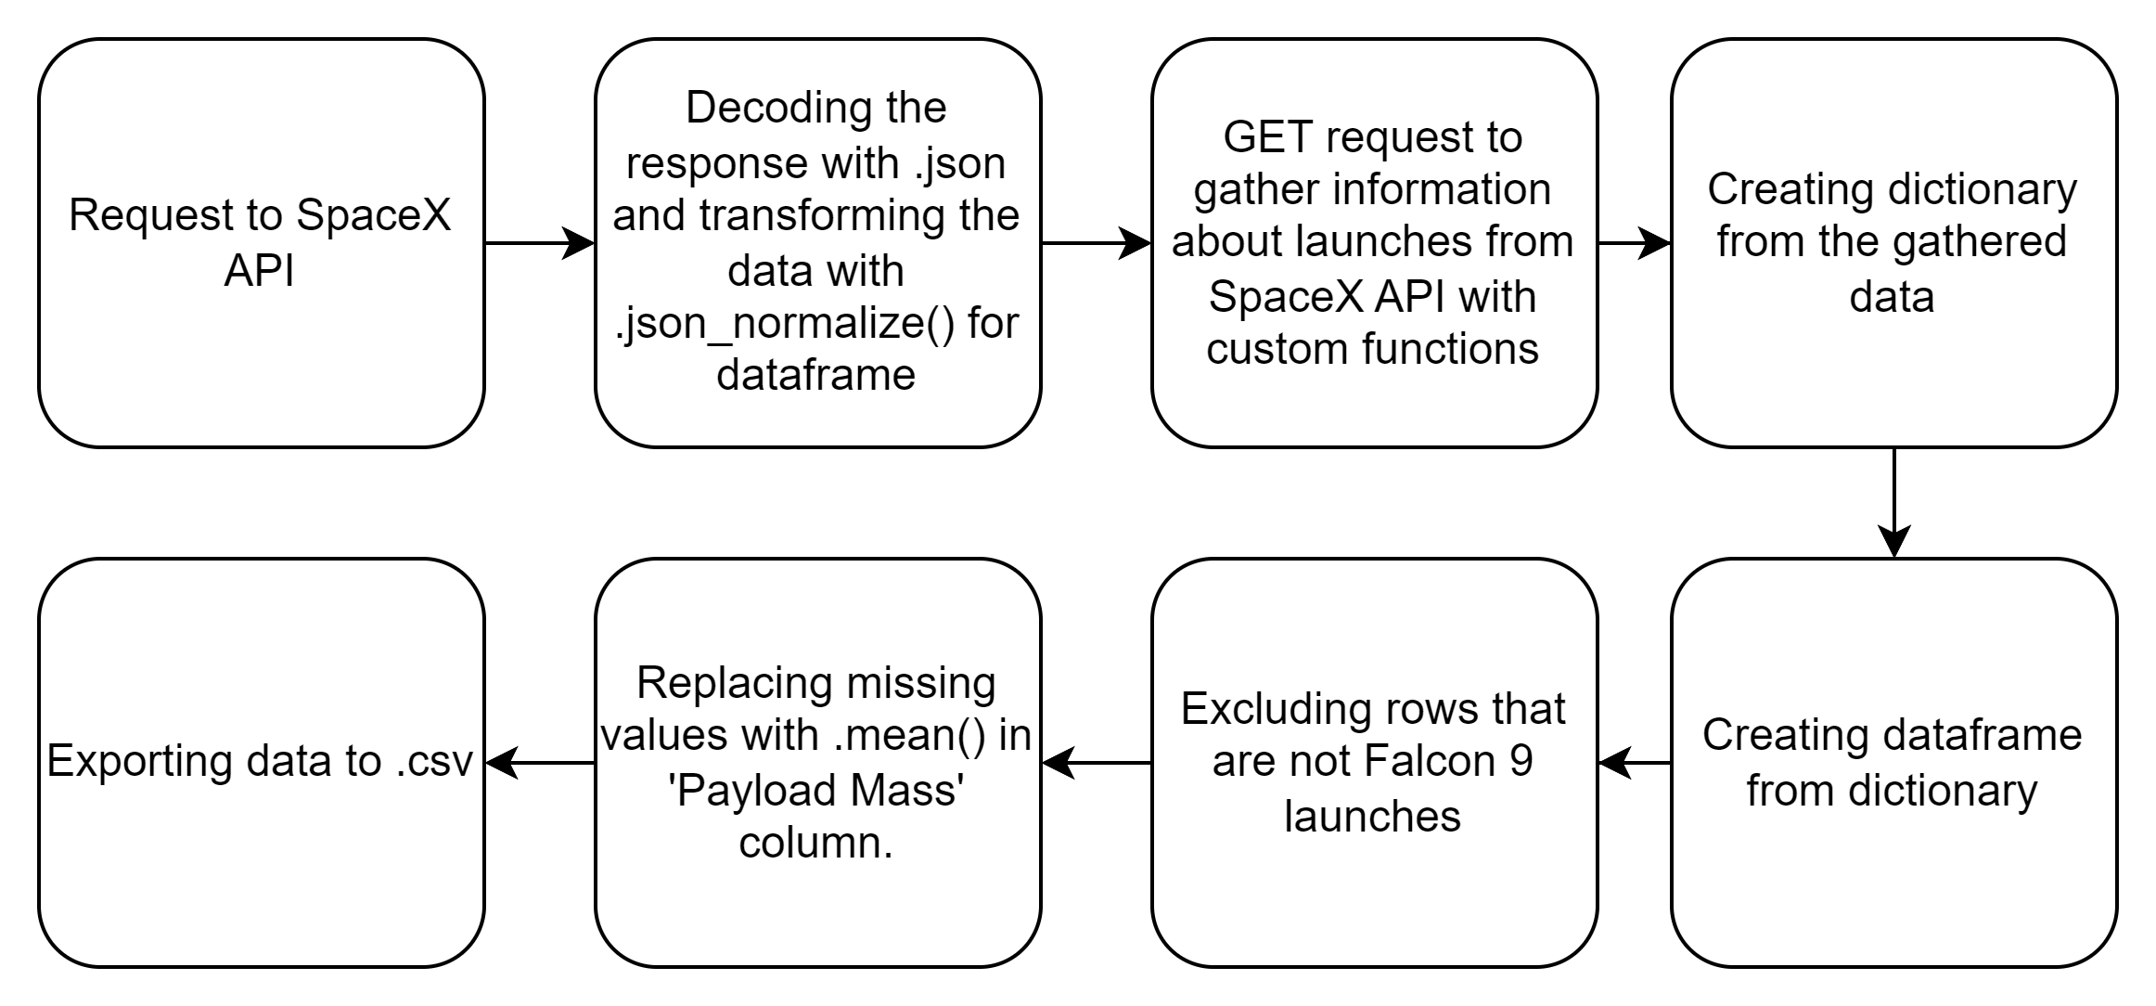
Data Collection – SpaceX API
SpaceX API has been used to gather information about launches of Falcon series. Data was transformed to be suitable for dataframe. Resulting data has been filtered with Falcon 9 launches and missing values has been filled with mean value of the column.
Link to the Notebook: Data Collection Notebook for SpaceX API

Slide 9
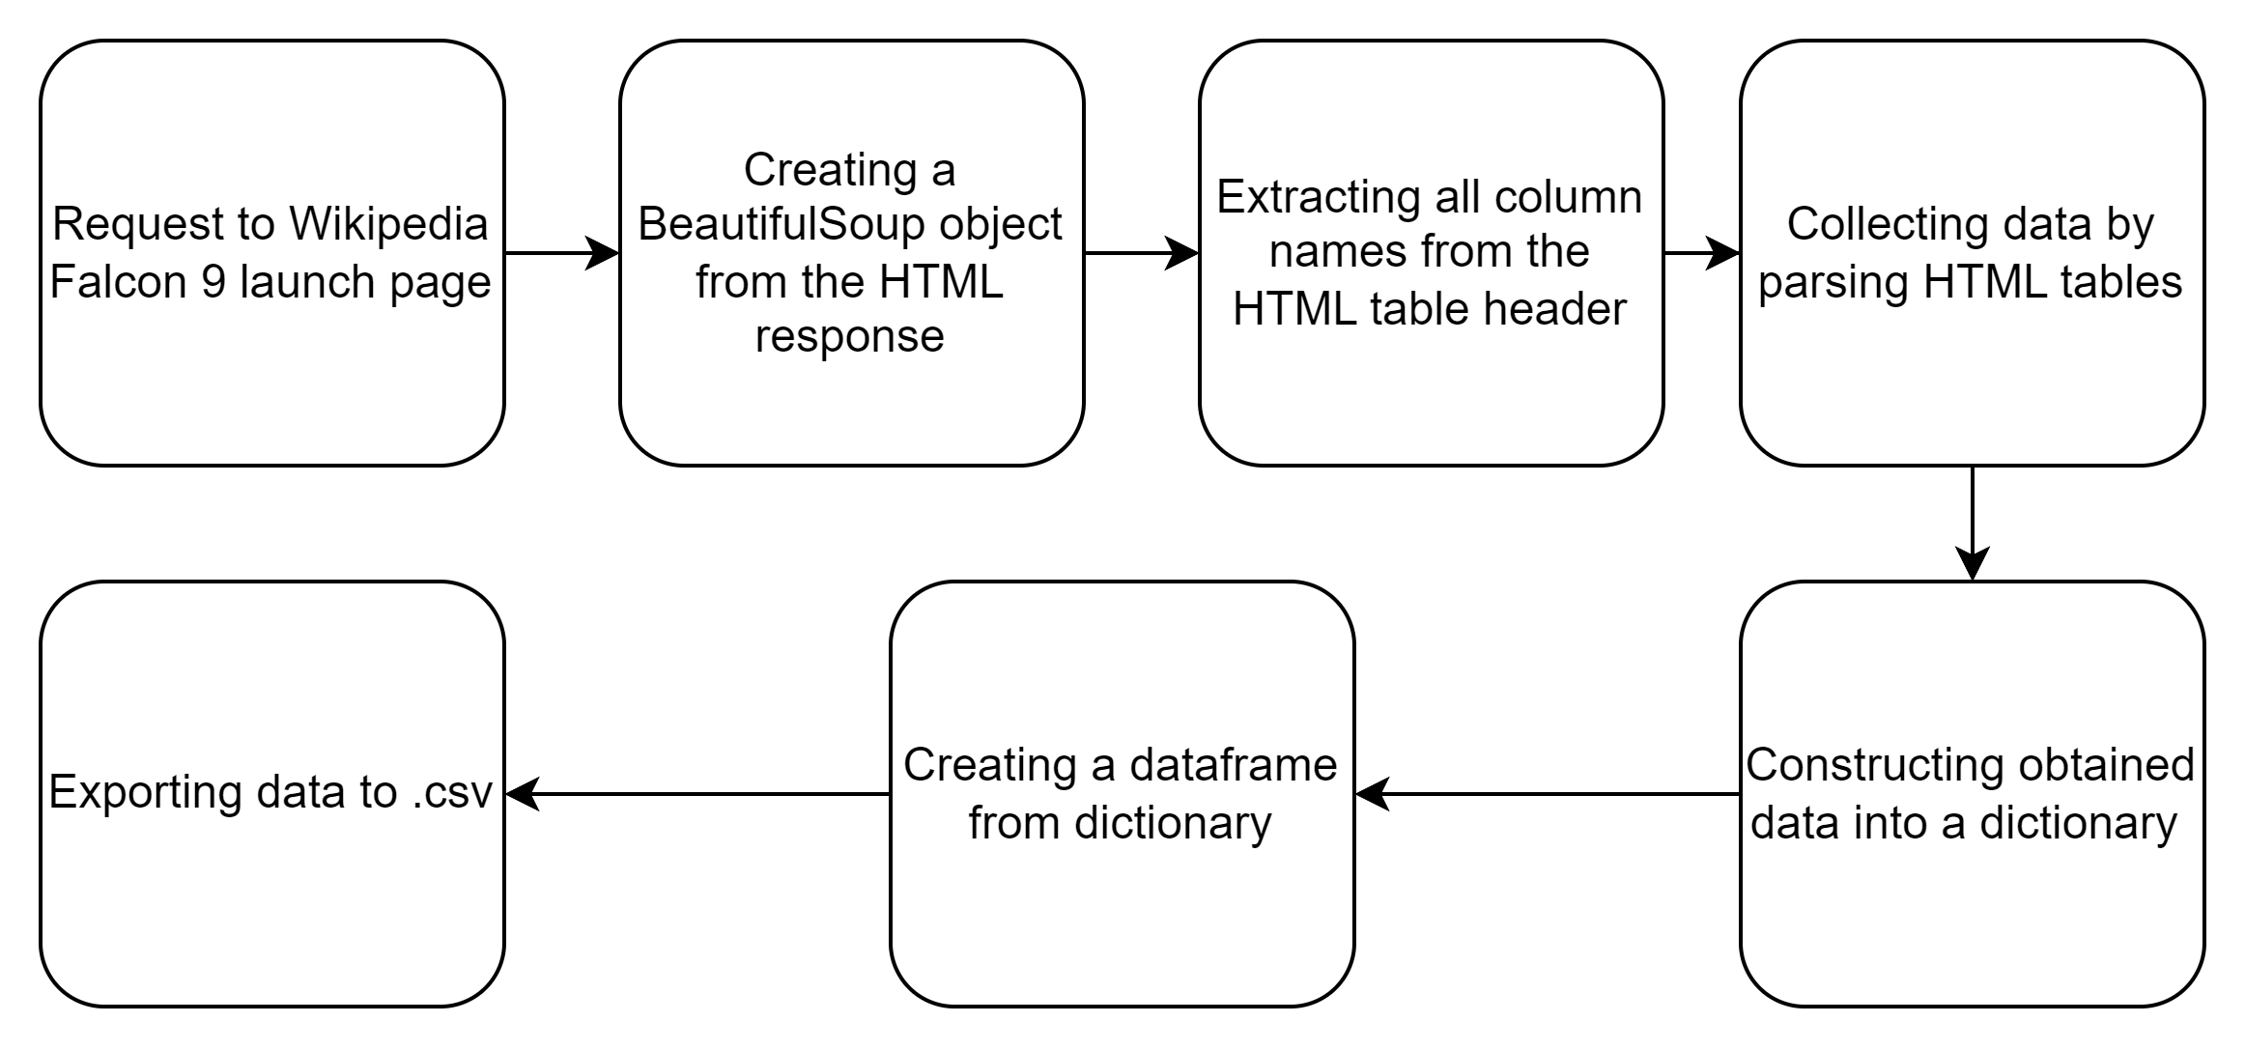
Data Collection - Scraping
Launch records has been mined through Wikipedia with BeautifulSoup for gathering Falcon 9 launch records. Results was parsed and turned into a pandas dataframe.
Link to the Notebook: Web Scraping Project with BeautifulSoup

Slide 10
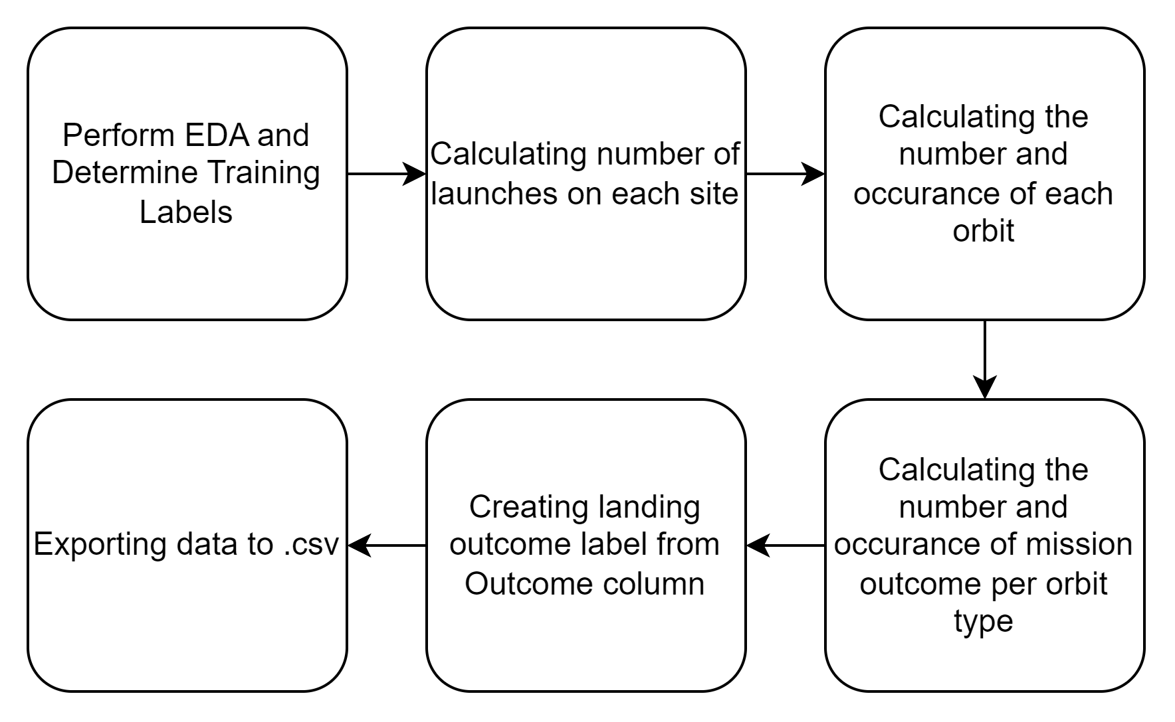
Data Wrangling
Our dataset details various booster landing scenarios. These scenarios fall into two categories: successful landings and unsuccessful landings.
Successful Landings:
True Ocean: Booster successfully landed in a designated ocean zone.
True RTLS: Booster successfully landed on a designated ground pad.
True ASDS: Booster successfully landed on a drone ship in the ocean.
Unsuccessful Landings:
False Ocean: Attempted landing in the ocean zone failed.
False RTLS: Attempted landing on the ground pad failed.
False ASDS: Attempted landing on the drone ship failed.
For machine learning purposes, we convert these outcomes into simpler labels: 1 for successful landings and 0 for unsuccessful landings.
Link to the Notebook: Data Wrangling

Slide 11
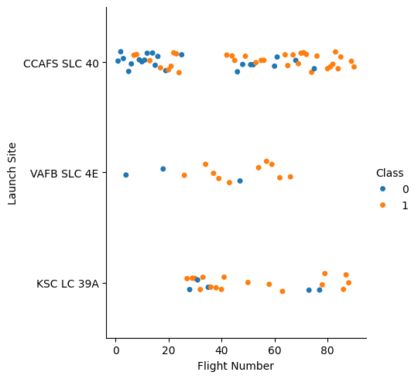
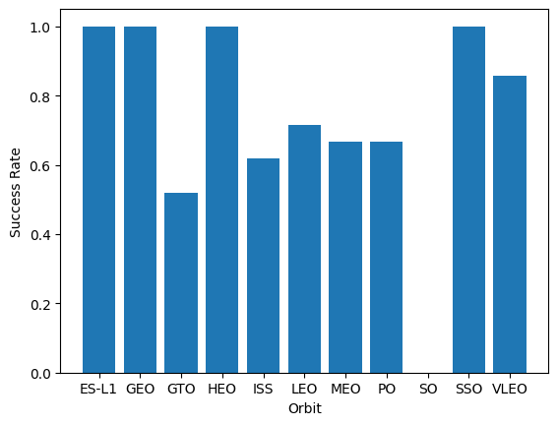
EDA with Data Visualization
Charts were plotted:
Flight Number vs. Payload Mass, Flight Number vs. Launch Site, Payload Mass vs. Launch Site, Orbit Type vs. Success Rate, Flight Number vs. Orbit Type, Payload Mass vs Orbit Type and Success Rate Yearly Trend
Scatter plots show the relationship between variables. If a relationship exists, they could be used in machine learning model.
Bar charts show comparisons among discrete categories. The goal is to show the relationship between the specific categories being compared and a measured value.
Line charts show trends in data over time (time series).
Link to the Notebook: EDA with Data Visualization

Slide 12
EDA with SQL
Sqlite was using for queries in SpaceX dataset.
EDA was applied wih SQL to get insight from the data. Queries were created for these purposes:
Names of unique launch sites in the space mission.
Total payload mass carried by boosters launched by NASA (CRS)
Average payload mass carried by booster version F9 v1.1
Total number of successful and failure mission outcomes
Failed landing outcomes in drone ship, their booster version and launch site names.
Link to the Notebook: EDA with SQL

Slide 13
Build an Interactive Map with Folium
All launch sites has been marked and markers, circles, lines added to point out success or failure of launches for each site on folium map.
Feature launch outcomes has been assigned with binary variable (0: Failure, 1: Success)
Colored markers has been added (Green/Red) to identify which launch sites have relatively high success rates.
Colored lines has been added to show distances between the launch site KSC LC-39A and its proximities like Railway, Highway, Coastline and Closest City
Link to the Notebook: Interactive Map with Folium

Slide 14
Build a Dashboard with Plotly Dash
Interactive dashboard has been created with Plotly Dash.
Dropdown list has been created for launch sites.
Pie charts has been created to show total launches by each site.
Scatter graph has been created to show relationship between Outcome and Payload Mass (kg) for different booster versions.
Slider has been created for Payload Mass Range.
Link to the Notebook: Web Scraping Project with BeautifulSoup

Slide 15
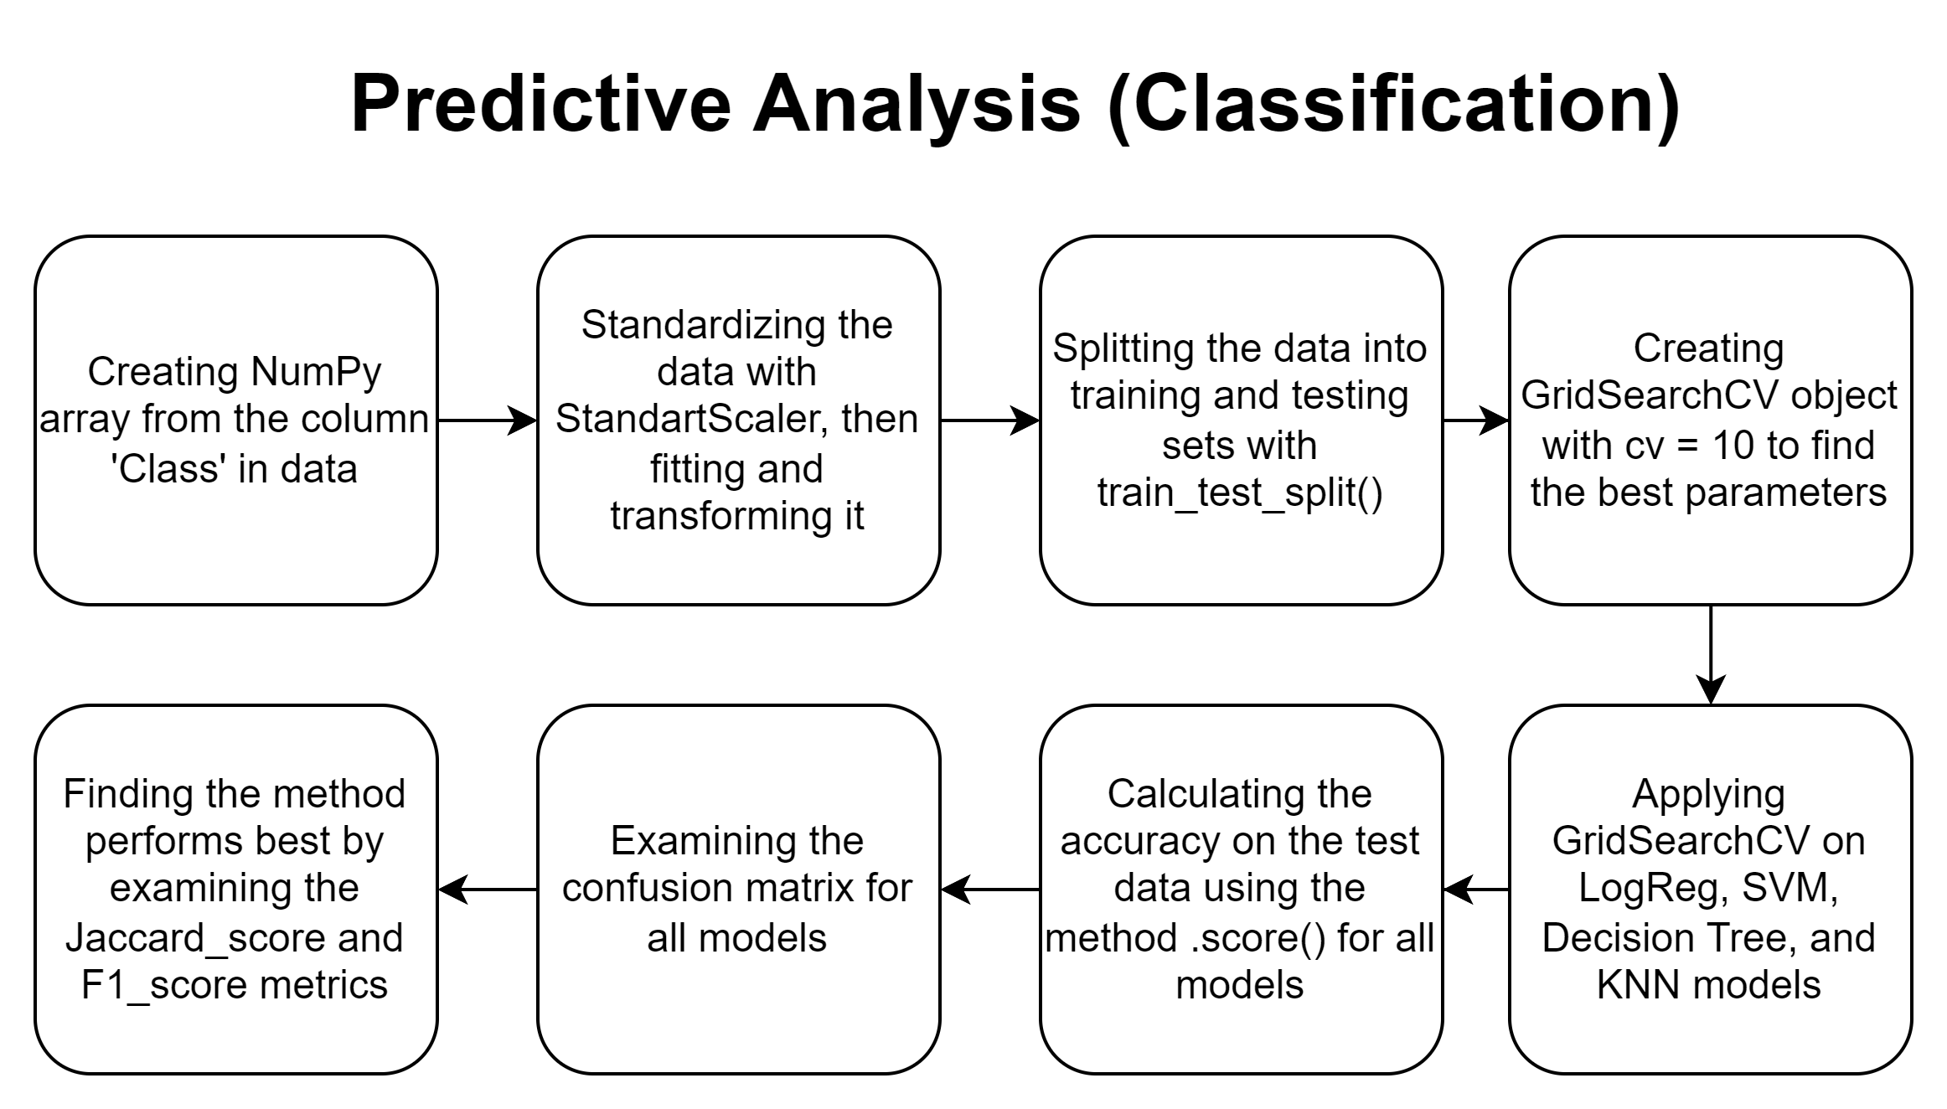
Predictive Analysis (Classification)
Link to the Notebook: Predictive Analysis (Classification)

Slide 16
Results
Exploratory data analysis results
Interactive analytics demo in screenshots
Predictive analysis results

Slide 17

Section 2

Slide 18
Flight Number vs. Launch Site
Earlist launch trials have been failed more while latest flights have been more successful.
CCAFS SLC 40 has about half of the launches.
VAFB SLC 4e and KSC LC 39A have higher success raters.
It can be assumed that more flight number can be resulted with higher rate of success.

Slide 19
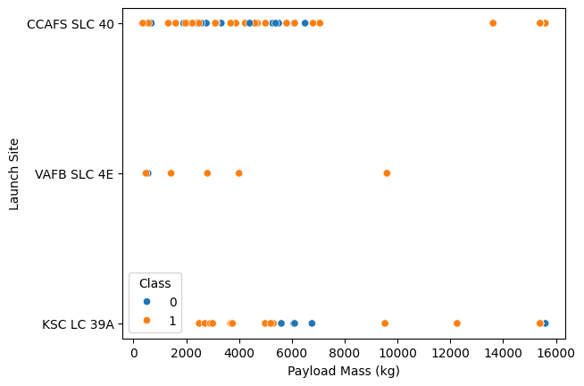
Payload vs. Launch Site
For each launch site; higher the payload mass, higher the success rate.
Most of the launches with payload mass over 7000 kg were successful.
KSC LC 39A has a 100% success rate for payload mass under 5500 kg too.

Slide 20
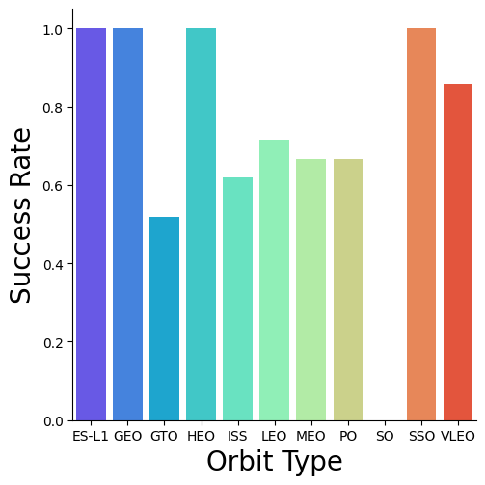
Success Rate vs. Orbit Type
Orbits with 100% success rate are:
ES-L1, GEO, HEO, SSO
Orbits with 0% success rate:
SO
Orbits with success rate between 50% and 85%:
GTO, ISS, LEO, MEO, PO

Slide 21
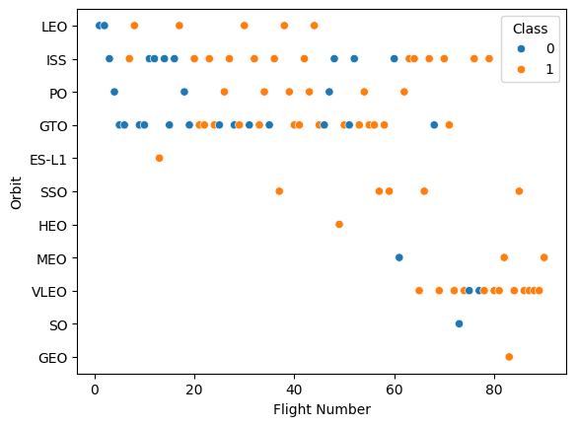
Flight Number vs. Orbit Type
There is no constant evidence for the relationship between Flight Number and Orbit Type.

Slide 22
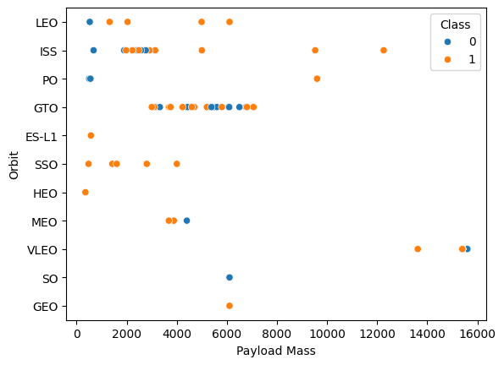
Payload vs. Orbit Type
Heavy payloads have a negative influence on GTO orbits and positive on GTO and Polar LEO (ISS) orbits.

Slide 23
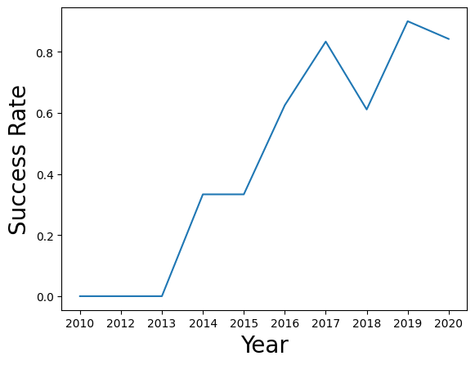
Launch Success Yearly Trend
Trials has been started at 2013 and linearly increased until 2017. Between 2017 and 2018 was at decrease with a fixation between 2018 and 2019.

Slide 24
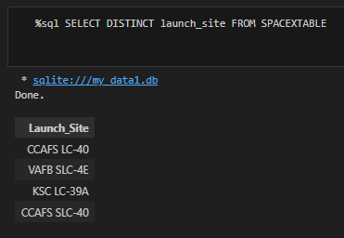
All Launch Site Names
Sqlite was used in Jupyter Notebook for this query.
From SPACEXTABLE table, each unique value has been shown in launch_site column.

Slide 25
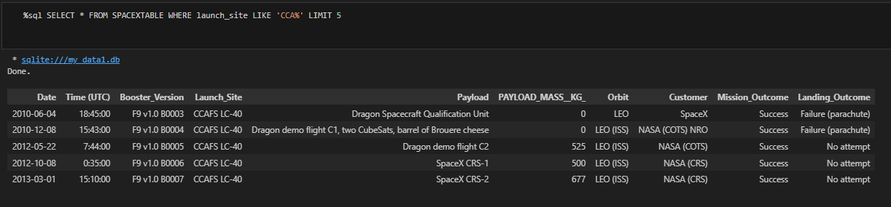
Launch Site Names Begin with 'CCA'
A query with ‘CCA’ filter was used with a limit of 5 to get records in launch sites that starts with CCA.

Slide 26
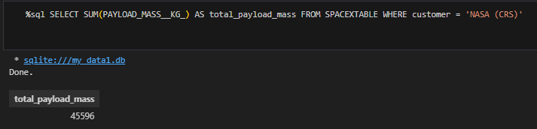
Total Payload Mass
Total payload mass carried by boosters launched by NASA (CRS) has been calculated with an aggregate function in the query.

Slide 27
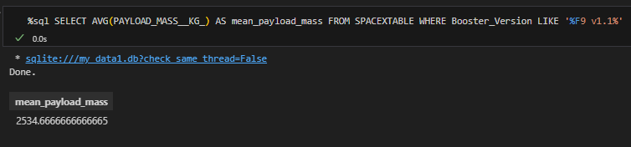
Average Payload Mass by F9 v1.1
Average payload mass carried by booster version F9 v1.1 resulted as 2534.67.

Slide 28
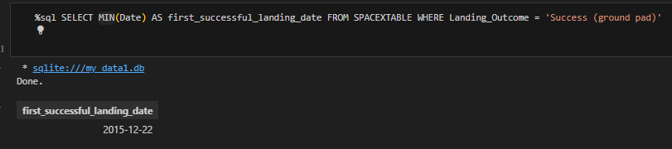
First Successful Ground Landing Date
Date of the first successful landing was achieved.

Slide 29
Successful Drone Ship Landing with Payload between 4000 and 6000
List the names of boosters which have successfully landed on drone ship and had payload mass greater than 4000 but less than 6000
Present your query result with a short explanation here

Slide 30
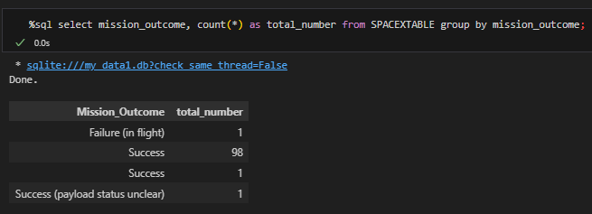
Total Number of Successful and Failure Mission Outcomes
Total number of successful outcome is 100 and failure is 1.

Slide 31
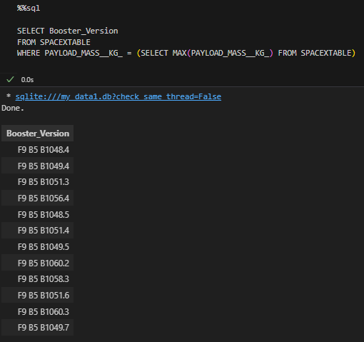
Boosters Carried Maximum Payload
List of the names that has the booster versions which have carried the maximum payload mass.

Slide 32
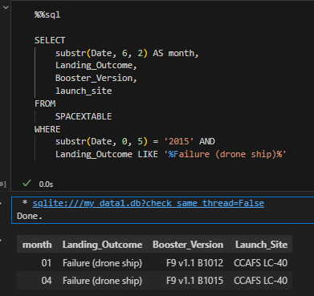
2015 Launch Records
Listing the failed landing outcomes in drone ship, their booster versions and launch site names for the months in year 2015.

Slide 33
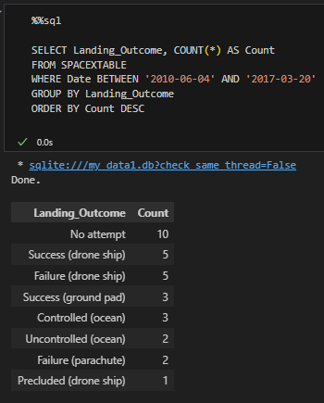
Rank Landing Outcomes Between 2010-06-04 and 2017-03-20
Ranking the count of landing outcomes between 2010-06-04 and 2017-03-20 in descending order.

Slide 34

Section 3

Slide 35
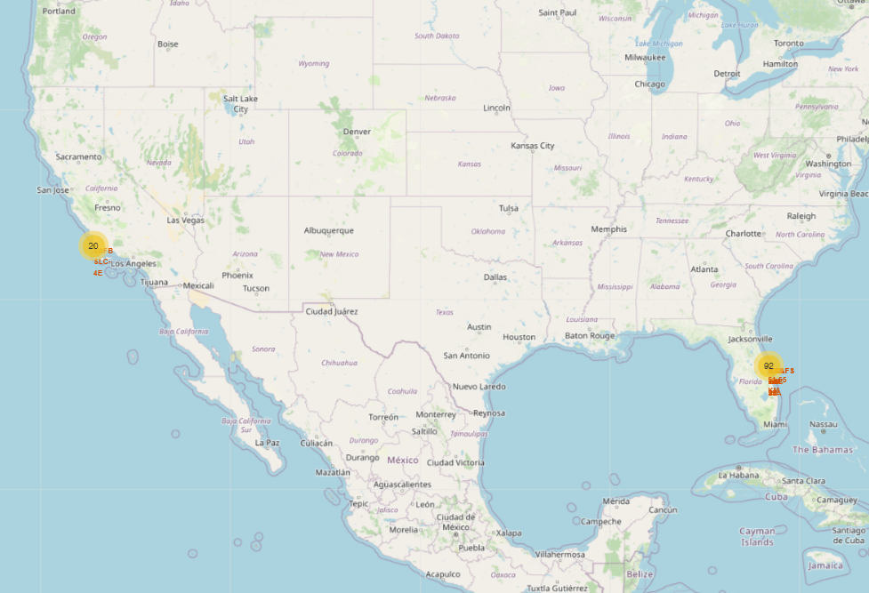
Launch Sites All Around United States
Launch sites are near the coast lines.
Launch sites are closer to the equator for more precise prediction.

Slide 36
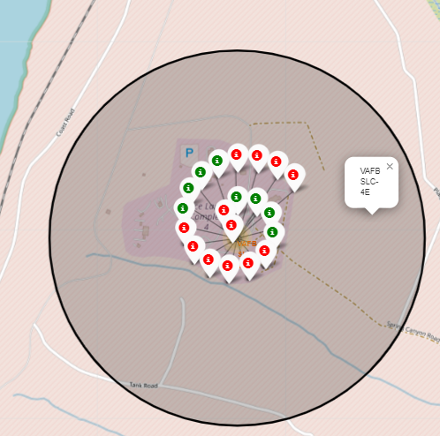
Success of Launches
Booster landing outcomes for each launch site can be seen with different color by their success. In addition to that, name of launching site can be seen as a pop-up too.

Slide 37
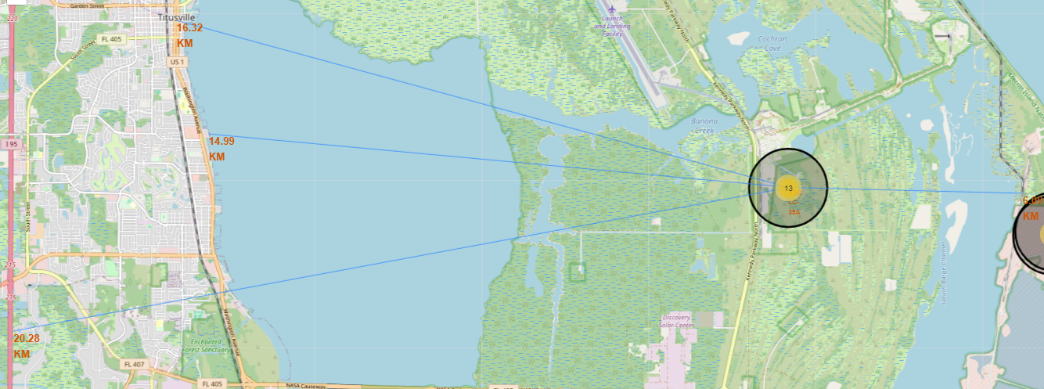
Distance From the Launch Site KSC LC-39A to its Proximity
Relative close to railway is 6 km, relative close to highway is 20.28 km, relative close to coastline is 14.99 km, relative close to its closest city Titusville is 16.32 km.

Slide 38

Section 4

Slide 39
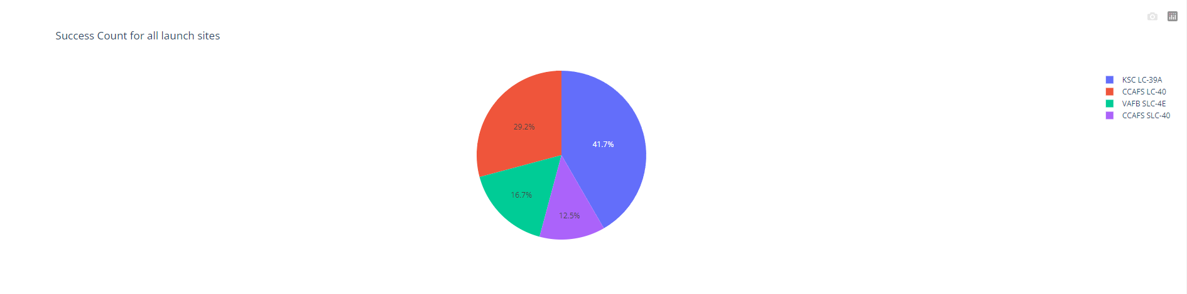
Launch success count for all sites
Pie chart shows that from all sites, KSC LC 39-A has the most successful launches.

Slide 40
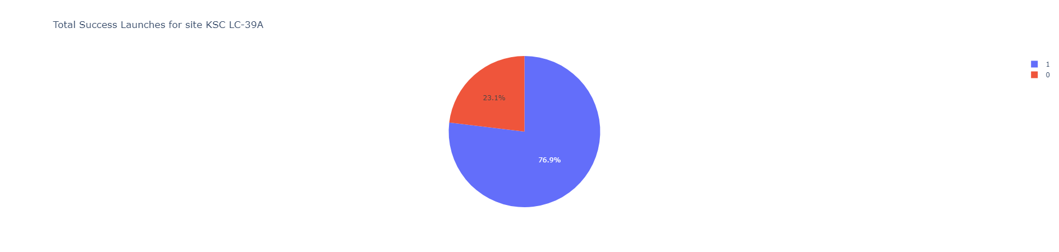
Launch site with highest launch success ratio
KSC LC-39A has the highest launch success rate (76.9%).

Slide 41
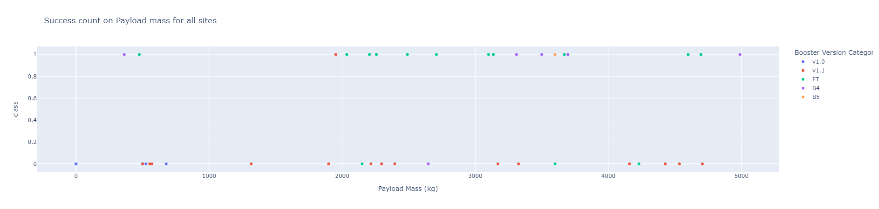
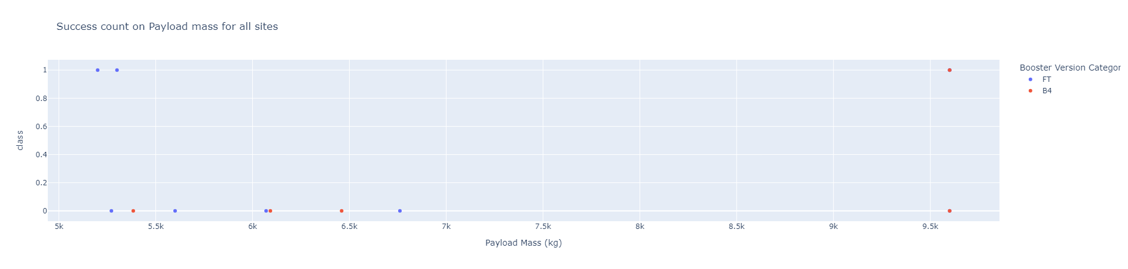
Payload Mass vs. Launch Outcome for all sites
The charts show that payloads between 2000 and 5500 kg have the highest success rate.

Slide 42

Section 5

Slide 43
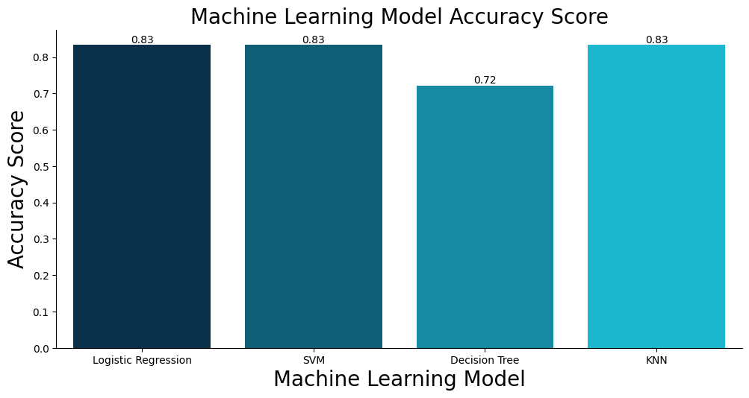
Classification Accuracy
All models performed equally well except for the Decision Tree model, which has a lower score (0.72) than others.

Slide 44

Confusion Matrix
This is the confusion matrix for he Logistic Regression model.
There are 12 True Positives and 3 True Negatives (Correctly Predicted)
There are 3 False Positives and 0 False Negatives (Falsely Predicted)

Slide 45
Conclusions
SpaceX doesn’t have perfect landing outcomes in Falcon 9 first stage landing trials.
SpaceX’s Falcon 9 trials are getting better with more launches.
Machine learning models, in our case, Logistic Regression model can be used to predict future trials and their outcomes.

Slide 46
Appendix
Additional Datasets:
SpaceX API (json): https://cf-courses-data.s3.us.cloud-object storage.appdomain.cloud/IBM-DS0321EN SkillsNetwork/datasets/API_call_spacex_api.json
Wikipedia (Webpage): https://en.wikipedia.org/w/index.php?title=List_of_Falcon_9_and_Falcon_Heavy_launches&oldid=1027686922
Launch Geo (CSV): https://cf-courses-data.s3.us.cloud-object-storage.appdomain.cloud/IBM-DS0321EN-SkillsNetwork/datasets/spacex_launch_geo.csv
Launch Dash (CSV): https://cf-courses-data.s3.us.cloud-object-storage.appdomain.cloud/IBM-DS0321EN-SkillsNetwork/datasets/spacex_launch_dash.csv
Main Datasets:
GitHub URL (CSV 1): https://github.com/freudisapothead/ibmcapstoneproject/blob/main/dataset_part_1.csv
GitHub URL (CSV 2): https://github.com/freudisapothead/ibmcapstoneproject/blob/main/dataset_part_2.csv
GitHub URL (CSV 3): https://github.com/freudisapothead/ibmcapstoneproject/blob/main/dataset_part_3.csv
GitHub URL (Launch Geo): https://github.com/freudisapothead/ibmcapstoneproject/blob/main/spacex_launch_geo.csv
GitHub URL (Launch Dash): https://github.com/freudisapothead/ibmcapstoneproject/blob/main/spacex_launch_dash.csv

Slide 47
Appendix-2 (Continued)
Jupyter Notebooks and Dash .py File:
GitHub URL (Data Collection): https://github.com/freudisapothead/ibmcapstoneproject/blob/main/jupyter-labs-spacex-data-collection-api.ipynb
GitHub URL (Web Scraping): https://github.com/freudisapothead/ibmcapstoneproject/blob/main/jupyter-labs-webscraping.ipynb
GitHub URL (Data Wrangling): https://github.com/freudisapothead/ibmcapstoneproject/blob/main/labs-jupyter-spacex-Data%20wrangling.ipynb
GitHub URL (EDA with SQL): https://github.com/freudisapothead/ibmcapstoneproject/blob/main/jupyter-labs-eda-sql-coursera_sqllite.ipynb
GitHub URL (EDA with Data Visualization): https://github.com/freudisapothead/ibmcapstoneproject/blob/main/jupyter-labs-eda-dataviz.ipynb
GitHub URL (Folium Maps): https://github.com/freudisapothead/ibmcapstoneproject/blob/main/lab_jupyter_launch_site_location.ipynb
GitHub URL (Dashboard File): https://github.com/freudisapothead/ibmcapstoneproject/blob/main/spacex_dash_app.py
GitHub URL (Machine Learning): https://github.com/freudisapothead/ibmcapstoneproject/blob/main/SpaceX_Machine_Learning_Prediction_Part_5.jupyterlite.ipynb

Slide 48


